Slide 1
FARMER ASSISTANT APPLICATION
GROUP MEMBERS:
Pratik Harde (8871)
Ibin Babu (8872)
Ananya Sharma (8908)
Mentor : Prof. Prachi Patil

Slide 2
Introduction
In India, a large portion of the economy and labour are derived from agriculture. India's farmers frequently struggle with choosing the wrong crop for their soil and using the wrong fertiliser, which is the biggest issue they confront. Due to this, they will see a huge decrease in productivity. The farmers' problem was fixed using our project.
Precision agriculture is a cutting-edge agricultural technique that makes use of research data on crop yield statistics, soil types, and attributes to suggest the optimum crop, fertiliser recommendations, and disease prediction based on site-specific characteristics. By doing this, crop selection errors become less frequent and productivity rises.

Slide 3
Problem Statement
Agriculture is one of the most significant occupations in India. Many people work in agriculture but are unable to identify the crops that would grow best in their soil. Meaning that some crops can only be grown in moist soil, while others need medium soil humidity to thrive, but both farmers and newcomers with an interest in farming are less likely to be aware of this.
There are now a relatively limited number of resources and software available to them that will aid in quality improvement. Farmer Assistant App of this kind uses machine learning.
This problem of farmers has been addressed through Farmer Assistance App

Slide 4
Objective
To develop a reliable model that can accurately estimate crop sustainability in a given state under specific climatic and soil conditions.
Give advice on the best crops to grow in the area so that the farmer doesn't suffer any losses.
Suggest fertilizers for crops with supported chemical properties.

Slide 5
Literature Survey
Sr. no | IEEE Paper | Research
1. | An IoT Based Smart Farming System Using Machine Learning (researchgate.net) | Data collection phase using sensors deploying in an agricultural field. Data cleaning and storage phase and predicting processing using some AI methods. Showed that AI techniques play a pivotal role in agriculture of precision by using machine learning and open sources technologies.
2. | High Resolution Mapping of Soil Properties Using Remote Sensing Variables in South-Western Burkina Faso: A Comparison of Machine Learning and Multiple Linear Regression Models (researchgate.net) | Four statistical prediction models–multiple linear regression (MLR), random forest regression (RFR), support vector machine (SVM), stochastic gradient boosting (SGB)–were tested and compared. Internal validation was conducted by cross validation while the predictions were validated against an independent set of soil samples considering the modelling area and an extrapolation area.
3. | Internet of things (IoT) applications to fight against COVID-19 pandemic - PMC (nih.gov) | IoT is used to capture health data from various locations of the infected patient and manage all the data using the virtual management system contact tracing, cluster identification and compliance of quarantine. By using a statistical-based method, IoT gets helpful to predict an upcoming situation of this disease.

Slide 6
Literature Survey
Sr. no | IEEE Paper | Research
4. | Soil Classification and Crop Suggestion using Machine Learning Techniques by IJRASET - Issuu | The model has been tested using various machine learning algorithms such as KNN, SVM and logistic regression. The accuracy of the present model is maximum than the existing models.
5. | Smart Agriculture Using WSN and IoT: Environment & Agriculture Book Chapter | IGI Global (igi-global.com) | This system monitors and collects the soil parameters from the field with the help of a wireless sensor network. The collected data is then uploaded in the cloud. Finally, the systems suggest best irrigation practices to the farmers by predicting the crop to be sown for next crop rotation. This system suggests further improving the effectiveness by predicting the suitable time for applying pesticides, fertilizer, and manures.
6. | Intelligent Agriculture System To Assist Farmers In Smart Decision (quickcompany.in) | The ML and IoT based suggestions will significantly educate the farmer and help them minimize costs and make strategic decisions by replacing intuition and passed-down knowledge with far more reliable data-driven ML models. provide intelligent agriculture system to assist farmers in smart decision making using IoT data analytics and machine learning.

Slide 7
Existing System
Researchers are increasingly devoting their time and energy to helping to address the issue as more and more people have started to notice this issue in Indian agriculture. To determine the proper crop sequence for a specific time stamp, many studies apply Regularized Greedy Forest. Another strategy suggests using historical records of meteorological data as a training set for a model. The model is trained to recognise weather conditions that hinder the assembling of apples. The production of apples is then accurately predicted using the concept of monthly weather trends.
To select a crop that supports the prediction yield rate, which is influenced by a number of criteria, the application of many algorithms, including Artificial Neural Network, K Nearest Neighbors, and Regularized Greedy Forest, is illustrated.
Pesticide forecasting and online trade supported agricultural goods are additional elements of the system.

Slide 8
THEORETICAL ANALYSIS
The crop recommendation system utilizes machine learning algorithms such as KNN, Decision Tree, and Random Forest to recommend suitable crops for a particular region based on soil and climatic conditions.
The fertilizer prediction system recommends the appropriate fertilizers for the recommended crops based on association rules mined from the dataset.
The disease detection system uses deep learning algorithms such as ResNet to detect plant diseases based on leaf images. Overall, the use of machine learning techniques in agriculture can provide farmers with valuable insights and recommendations, leading to higher yields and economic benefits.

Slide 9
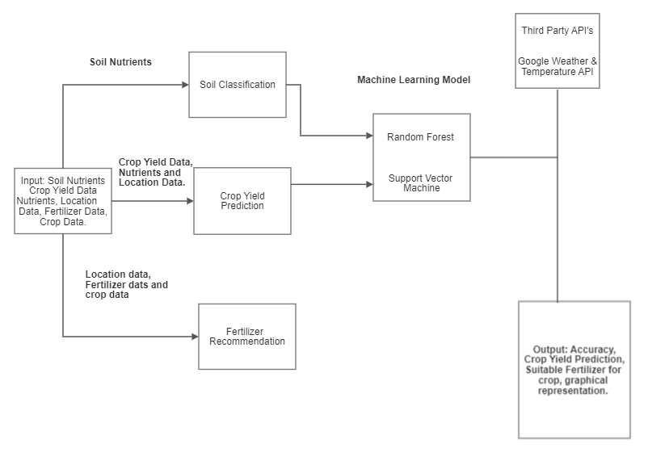
Design / Methodology

Slide 10
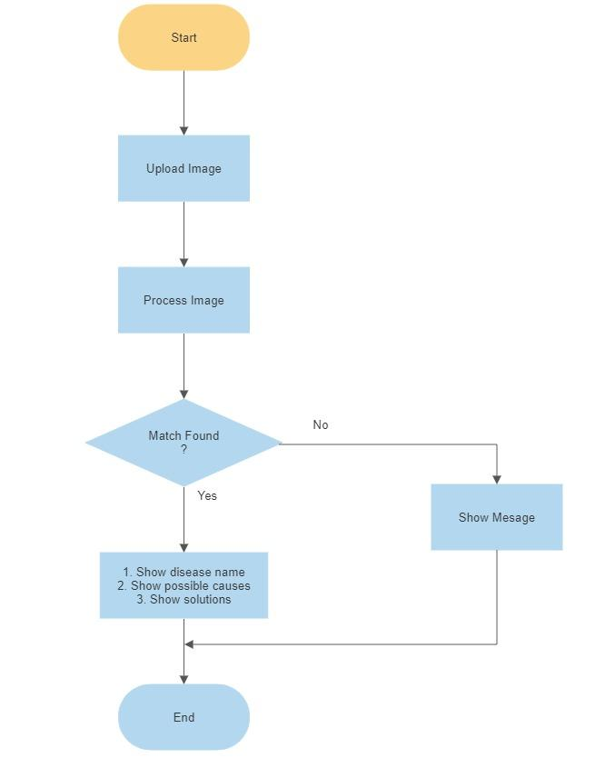
Design / Methodology

Slide 11
Implementation
The steps involved in this system implementation are :-
a) Acquisition of Training Dataset: The accuracy of any machine learning algorithm depends on the number of parameters and the correctness of the training dataset. For the system, we are using various datasets all downloaded for government website and kaggle.
Datasets include:- Yield dataset, Fertilizer dataset ,Soil nutrient content dataset, Rainfall, Temperature dataset
b). Data Preprocessing: This step includes replacing the null and 0 values for yield by -1 so that it does not effect the overall prediction. Further we had to encode the dataset so that it could be fed into the our ML models.
c). Training ML model : After the preprocessing step we used the dataset to train different machine learning models like Random forest, Decision Tree, Support Vector Machine(SVM) and Logistic regression to attain accuracy as high as possible.
d).Model Evaluation and Saving Model: All the ML models which are trained would be evaluated by comparing their performance (Evaluations Metrics) and Final efficient model is saved using pickle library.
e).Model Exportation and Integration with Webapp: The saved efficient ML model would be integrated with Flask Web Application which would further meant for prediction in user friendly web interface.

Slide 12
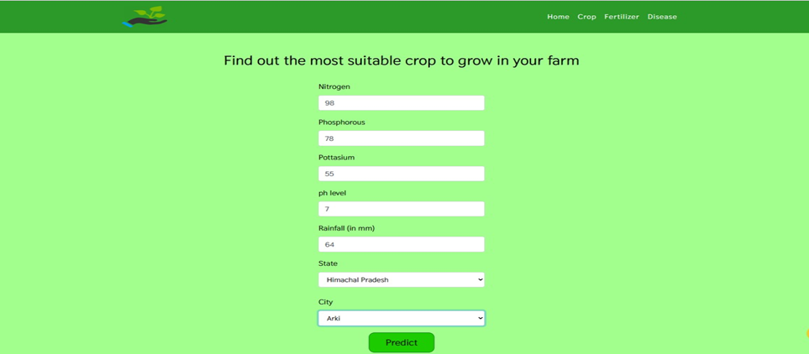
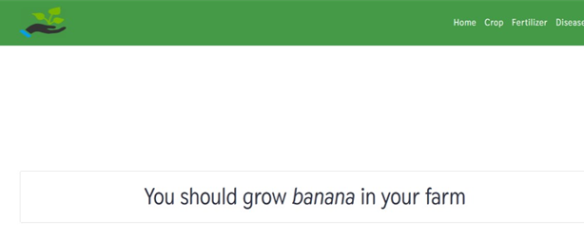
Result
Crop Recommendation
Input
Output

Slide 13
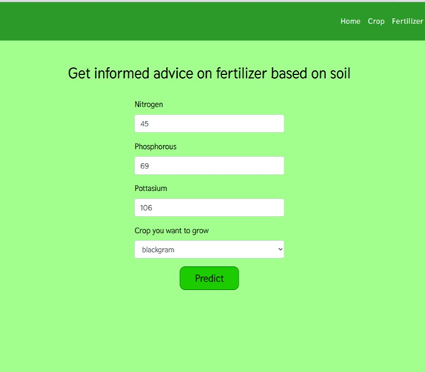
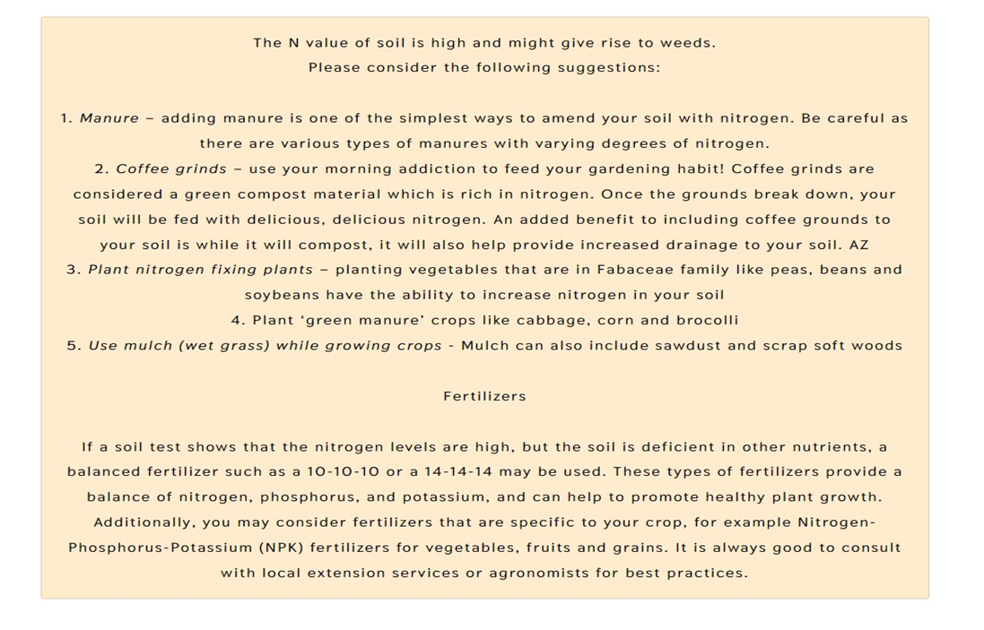
Result
Fertilizer Recommendation
Input
Output

Slide 14
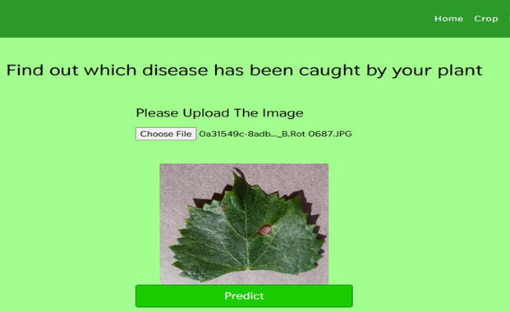
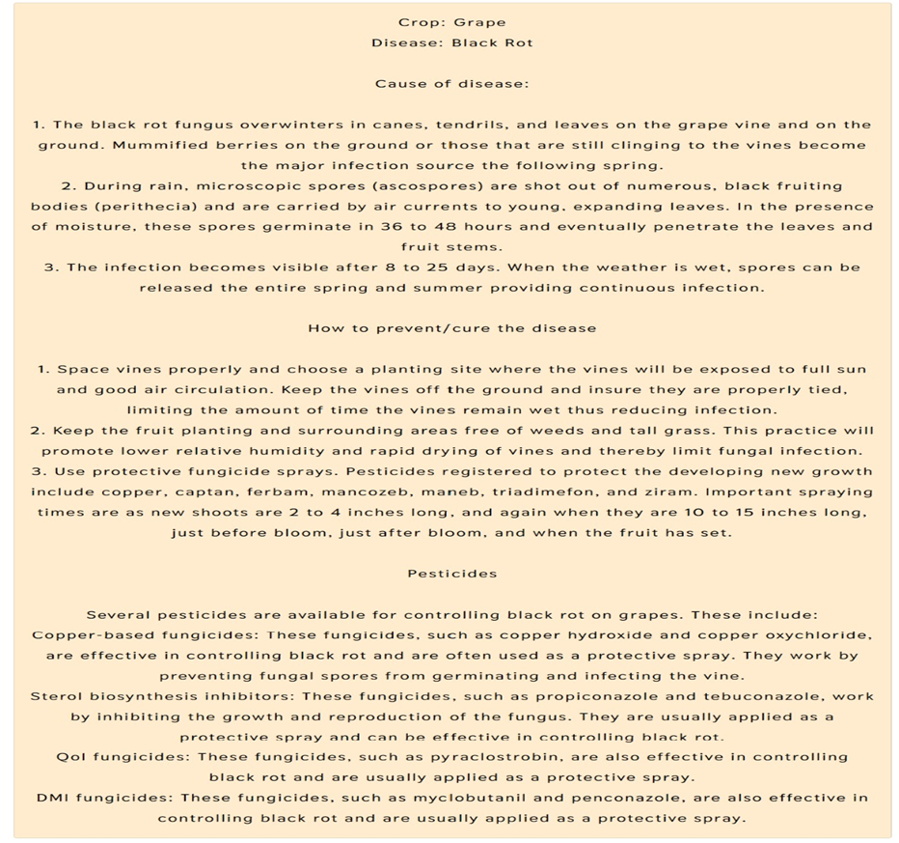
Result
Disease Detection
Input
Output

Slide 15
Algorithms & Accuracy
We used a series of ML algorithms such as
Algorithm | Accuracy (%)
Decision Tree | 90%
SVM | 97%
Logistic Regression | 95%
Random Forest | 99%

Slide 16
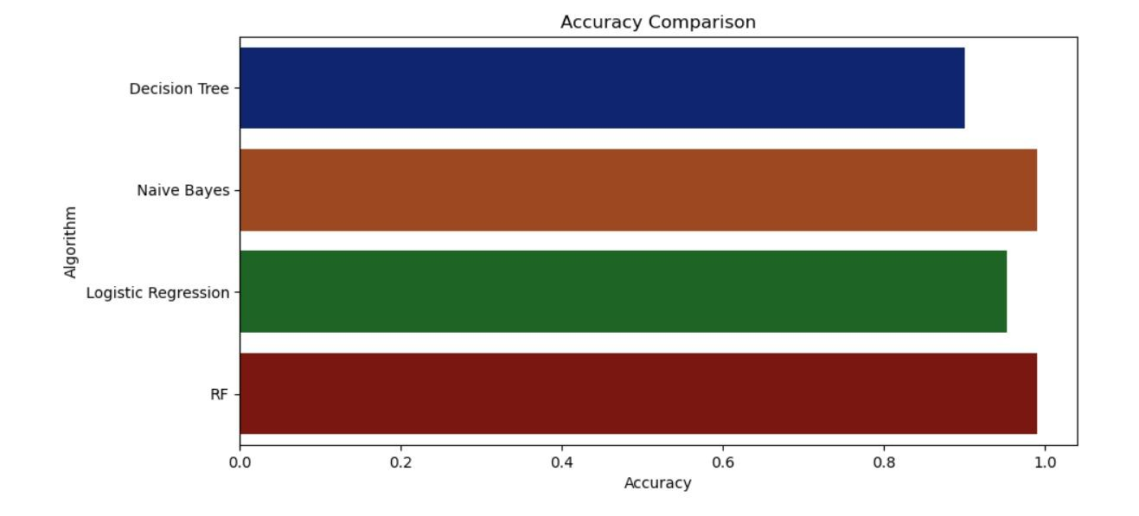
Accuracy Comparison
Hence, Random Forest is our Final efficient model

Slide 17
Algorithms:
For the purposes of this project we have used four popular algorithms:
Decision Trees, Logistic regression, Support Vector Machine and Random Forest.
All the algorithms are based on supervised learning. Our overall system is divided
into three modules:
Crop recommender
Fertilizer Recommender/Suggestion
Disease Detector

Slide 18
Conclusion:
Thus, our work would help farmers in sowing the right seed based on soil requirements to increase productivity and acquire profit out of such a techniques.
Our future work is aimed at an improved data set with large number of attributes and also implements yield prediction.

Slide 19
Software & Hardware Requirements
Hardware System Configuration:
Processor: 2 gigahertz (GHz) or faster processor.
RAM: 4 gigabyte (GB) for 32-bit or 4 GB for 64-bit.
Hard disk space: =>16GB.
Software Configuration:
Operating System: Windows XP/7/8/8.1/10, Linux and Mac
Coding Language: Python
Tools: Pandas, Numpy ,Seaborn , Pickle,Scikit-learn, Pytorch & ResNet
Framework: Flask
Other Tools : HTML, CSS, Bootstrap

Slide 20
References
[1] 2019, 10th International Conference on Computing, Communication and Networking Technologies, “Low-cost IOT+ML design for smart farming with multiple applications”, Fahad Kamraan Syed, Agniswar Paul, Ajay Kumar, Jaideep Cherukuri.
[2] 2019 IEEE “ Smart Management of Crop Cultivation using IoT and Machine Learning” Archana Gupta, Dharmil Nagda, Pratiksha Nikhare, Atharva Sandbhor
[3] Radhika, Narendiran, “Kind of Crops and Small Plants Prediction using IoT with Machine Learning,” International Journal of Computer & Mathematical Sciences, 2018.
[4] “Crop Recommendation on Analyzing Soil Using Machine Learning” Anguraj.Ka, Thiyaneswaran.Bb, Megashree.Gc, Preetha Shri.J.Gd, Navya.Se, Jayanthi. Jf, 2020.
[5] “Classification of Soil and Crop Suggestion using Machine Learning Techniques”, A. Mythili , IEEE 2019.
[6] Mehta, P., Shah, H., Kori, V., Vikani, V., Shukla, S., & Shenoy, M.,2018. “Survey of unsupervised machine learning algorithms on precision agricultural data”, IEEE
[7] “IOT based Crop Recommendation, Crop Disease Prediction and Its Solution” Rani Holambe, Pooja Patil, Padmaja Pawar, Saurabh Salunkhe , Mr. Hrushikesh Joshi, 2019 IRJET

Slide 21
THANK YOU

